Slide 1
SQL ( Structured Query Language)
Topic : ORDER BY Clause

Slide 2
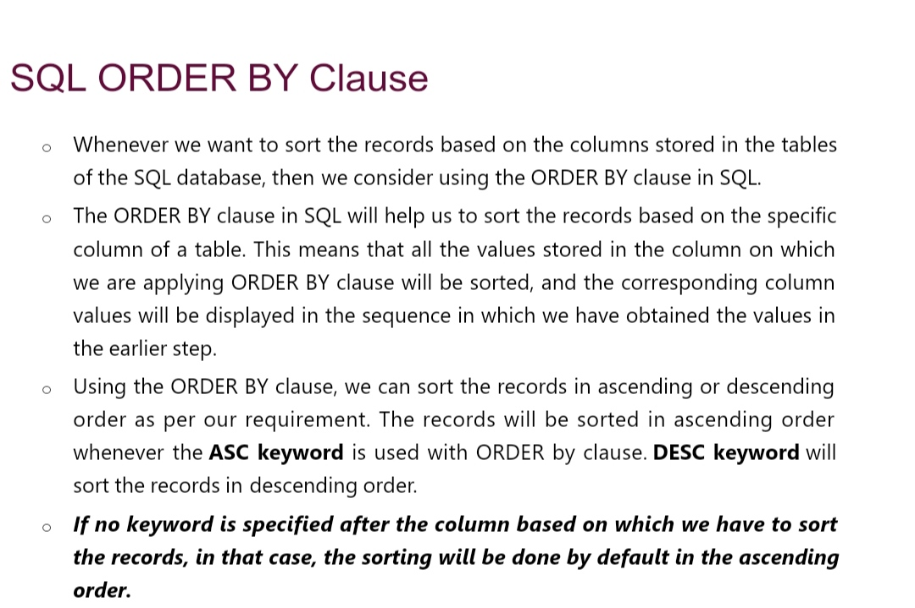
CONTENTS
01
02
03
04
Enter title
Enter title
Enter title
Enter title

Slide 3
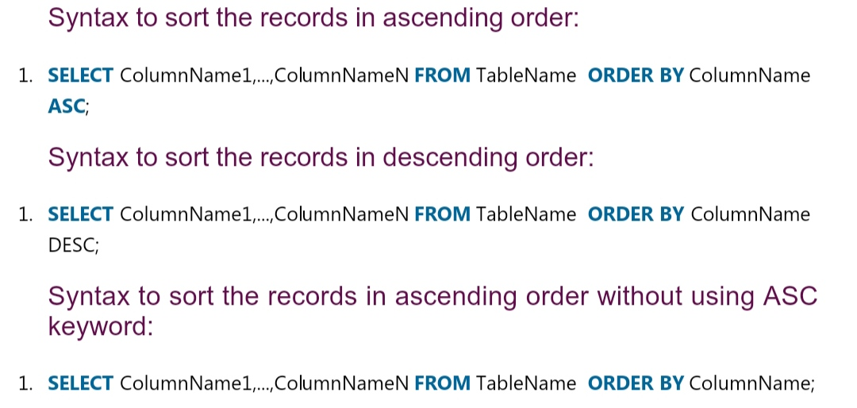
01
Enter title

Slide 4
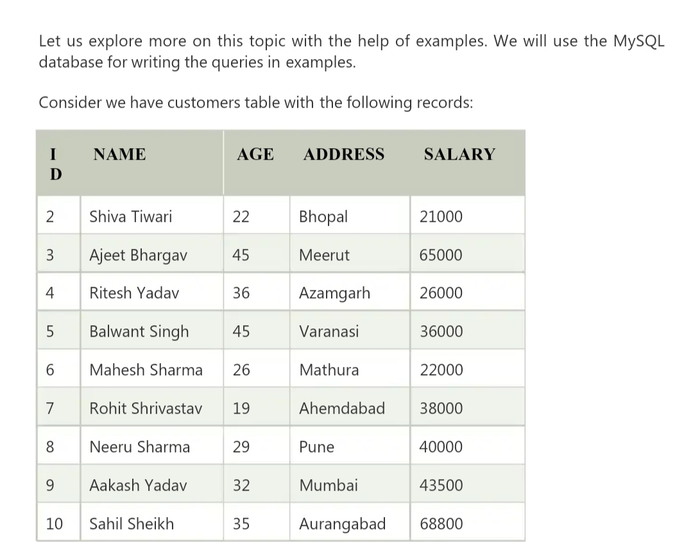
Enter title
Enter title
Click here to add content of the text Click here to add content of the text Click here to add content of the tex

Slide 5
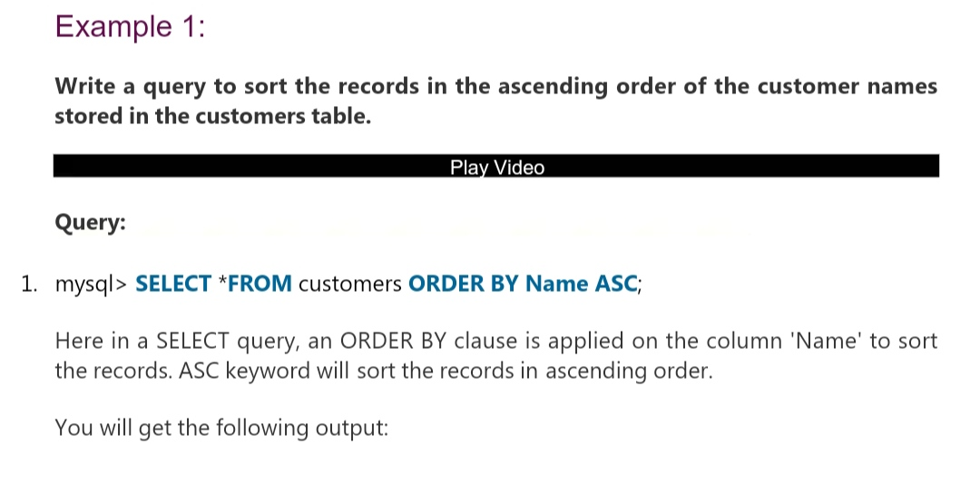
02
Enter title

Slide 6
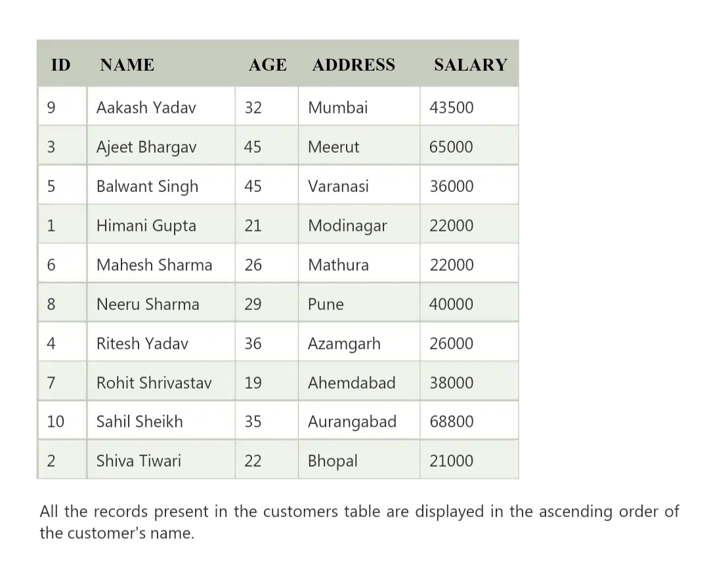

Enter title
Enter title
Click here to add content of the text Click here to add content of the text

Slide 7
End

